Slide 1
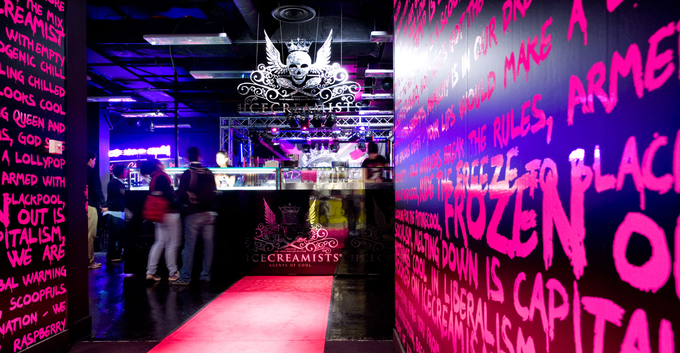
^{Defining} ^{Retail} ^{Excellence}

Slide 2
Congratulations on being selected as one of the Top 100 stores in Ireland. This Powerpoint is your application for consideration for the next stage of the competition; the Top 30. This year we will judge the store of the year based upon 10 categories of retail excellence. We have produced a separate inspiration guide to accompany this application, which should be read first. This explains how we define retail excellence and how we will judge the awards.

Slide 3
Your entry – please complete*
Store name
Instructions:
Please photograph your store based upon the 10 categories and insert images into each relevant section. Please also include a short overview to explain your thinking and why you think it represents retail excellence.
We will judge your store based on these images and descriptions, so do make your pictures as clear, explanatory and good looking as possible.
Enter name here
Store address
Enter address here

Slide 4
This year, we will judge the store of the year based on10 categories of retail excellence. These are grouped within 5 major themes, which show how retailers can attract and inspire customers, creating a winning retail formula. These themes follow the customer journey, from first impressions of the brand, through to creativity of design and display, tone of voice and storytelling. Communicating expertise with curated solutions, and personalisation are key elements. Technology that adds genuine value to the customer turns a gimmick into tool, whilst a focus on making stores community spaces creates welcoming places to be and to buy.
5 Themes
10 Categories

Slide 5
1 / First impressions /shopfront/windows/first bite
2 / Surprise & delight /visual merchandising/store design
3 / Expert solutions /curation/personalisation
4 / Talking shop /storytelling & communication
5 / Adding value /hospitality & community/technology
5 Themes
10 Categories

Slide 6
The shopfront
The shopfront is the face of your business. It’s where customers first connect in the real world. Whether contemporary or traditional, the architecture, branding and signage, should reflect the personality of the brand.
Category 1

Slide 7
The shopfront
Please explain a little bit about this*
Add text here

Slide 8
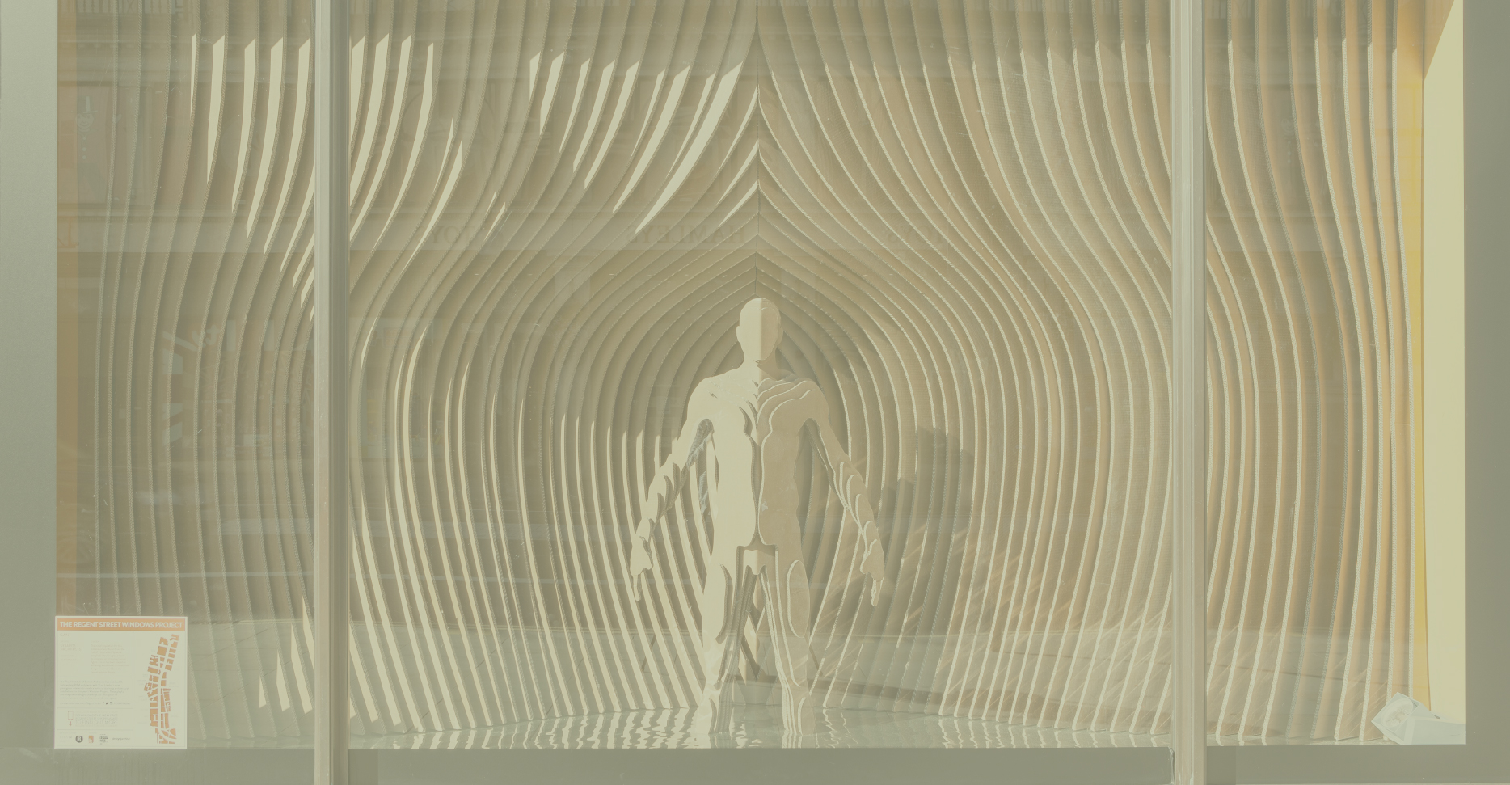
Windows
Windows allow a store to stay fresh and inventive, giving customers a reason to revisit. The best windows are eye catching, witty and playful, but above all creative.
Category 2

Slide 9
Windows
Please explain a little bit about this*
Add text here

Slide 10
First Bite
The best stores give a powerful, easy to read impression on entering the threshold, which reflects the ethos of the brand. We call this ‘first bite’.
Category 3

Slide 11
First Bite
Please explain a little bit about this*
Add text here

Slide 12
Visual Merchandising
The key to great retail is merchandising that engineers desire. Nothing you sell should look boring or better out of the store than in. Great visual merchandising shows off your expert creativity and makes shopping a visual treat.
Category 4

Slide 13
Visual Merchandising
Please explain a little bit about this*
Add text here

Slide 14
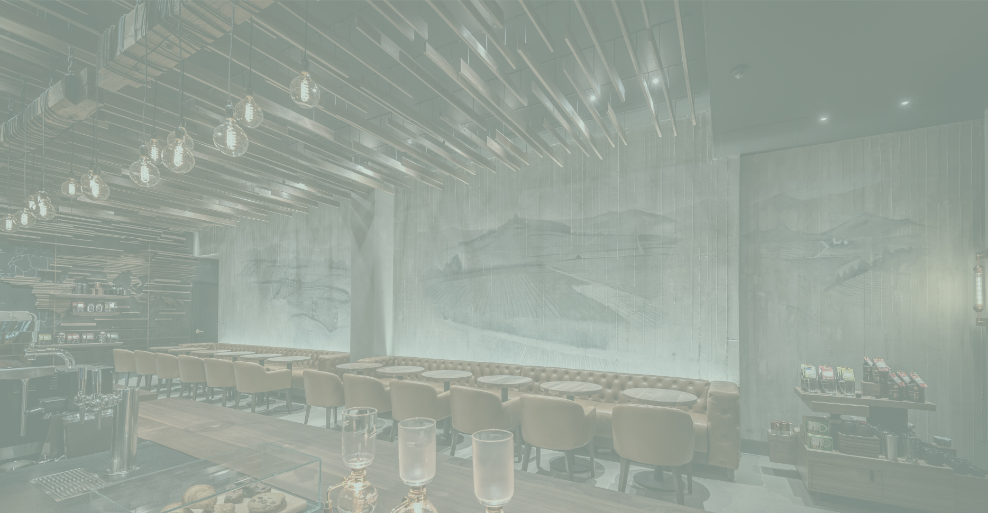
Interior design
Design matters. Customer expectations are higher than ever. From fixtures, to materials, lighting and colour, every element is an opportunity to wow. The cookie-cutter rollout is dead, and retailers are building unique stores for each location.
Category 5

Slide 15
Interior design
Please explain a little bit about this*
Add text here

Slide 16
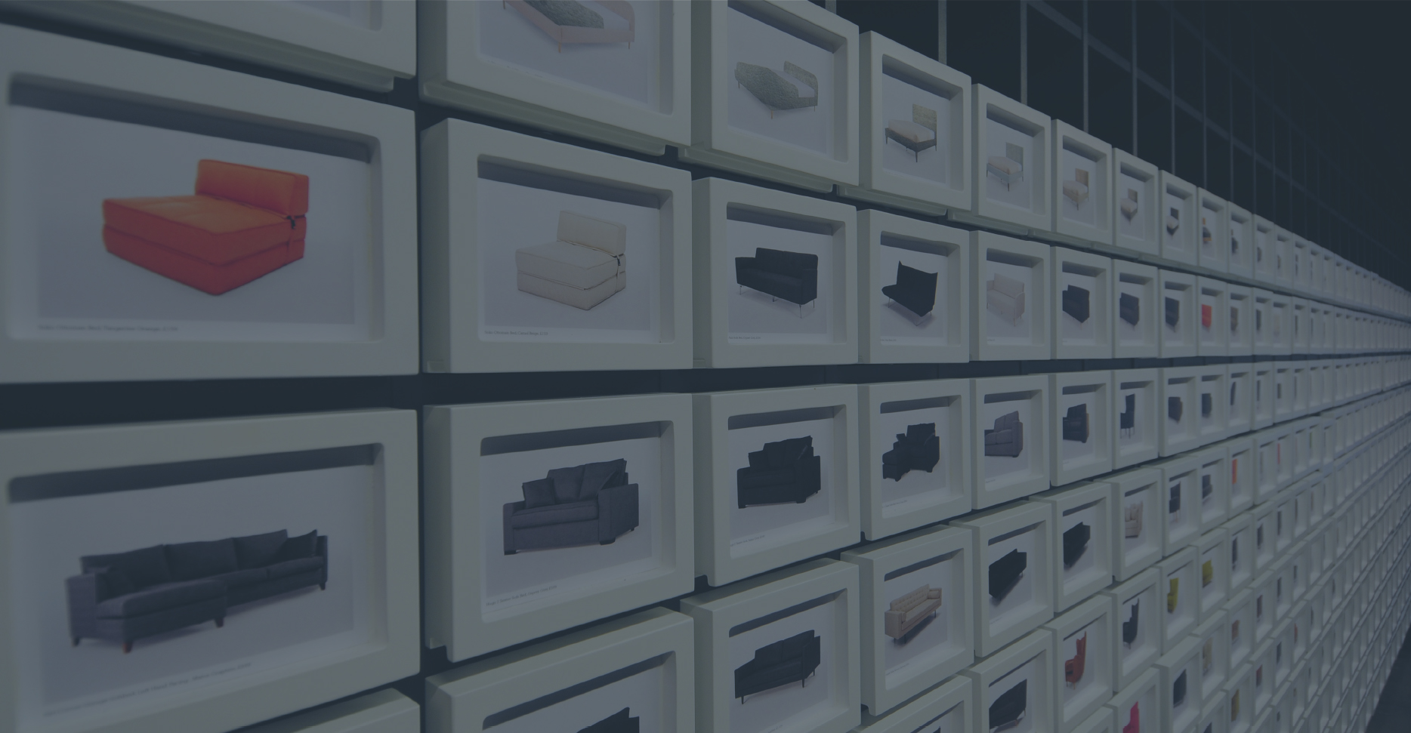
Curation
Products on shelves just don’t cut it anymore. The best retailers present products as solutions, in ways that are inspiring, trustworthy and easy to understand.
Category 6

Slide 17
Curation
Please explain a little bit about this*
Add text here

Slide 18
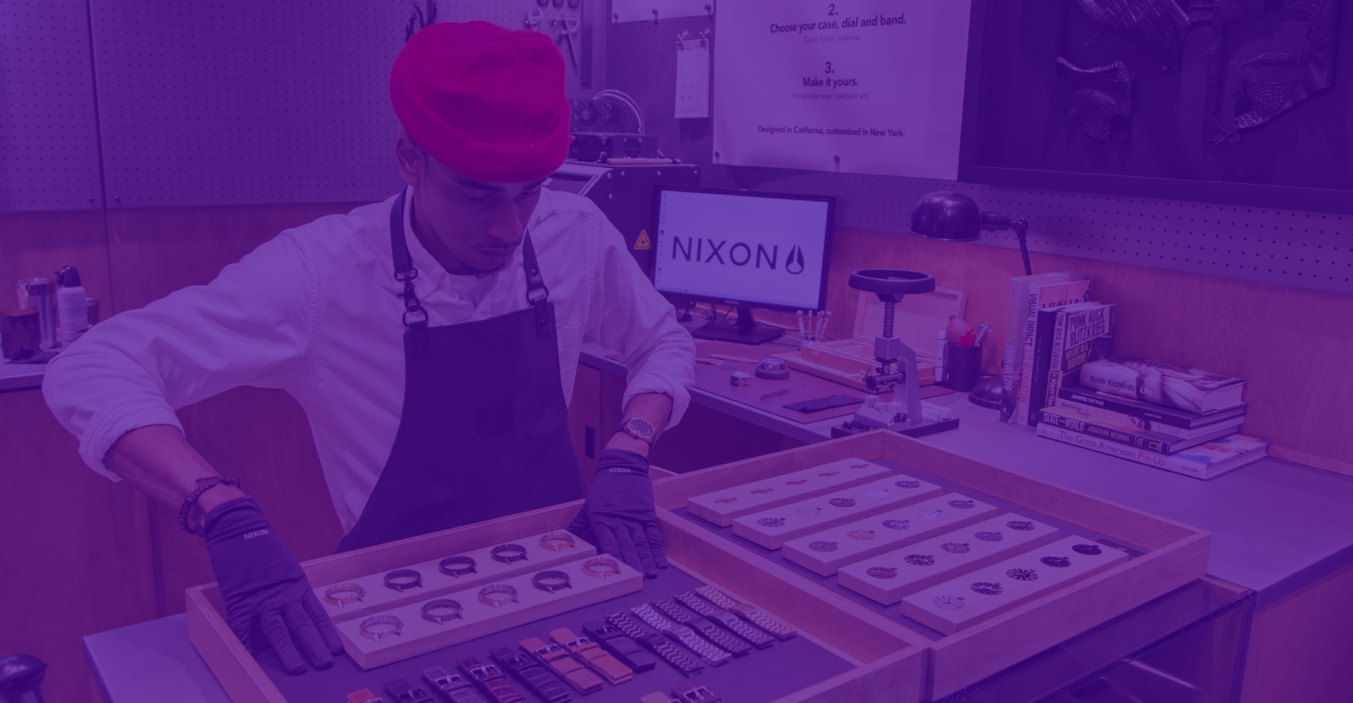
Personalisation
Products that are personalised instantly become more precious and treasured. Technology allows for much easier and more theatrical personalisation instore, whilst the traditional values of the craftsman are more important than ever.
Category 7

Slide 19
Personalisation
Please explain a little bit about this*
Add text here

Slide 20
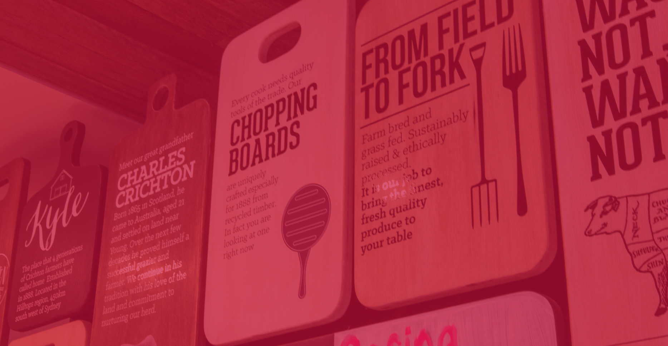
Communication
Communication is how brands establish trust and demonstrate their passion and expertise. Whether it’s digital or analogue, storytelling is vital. Creating a distinctive tone of voice, gives a brand a unique personality and helps customers to connect.
Category 8

Slide 21
Communication
Please explain a little bit about this*
Add text here

Slide 22
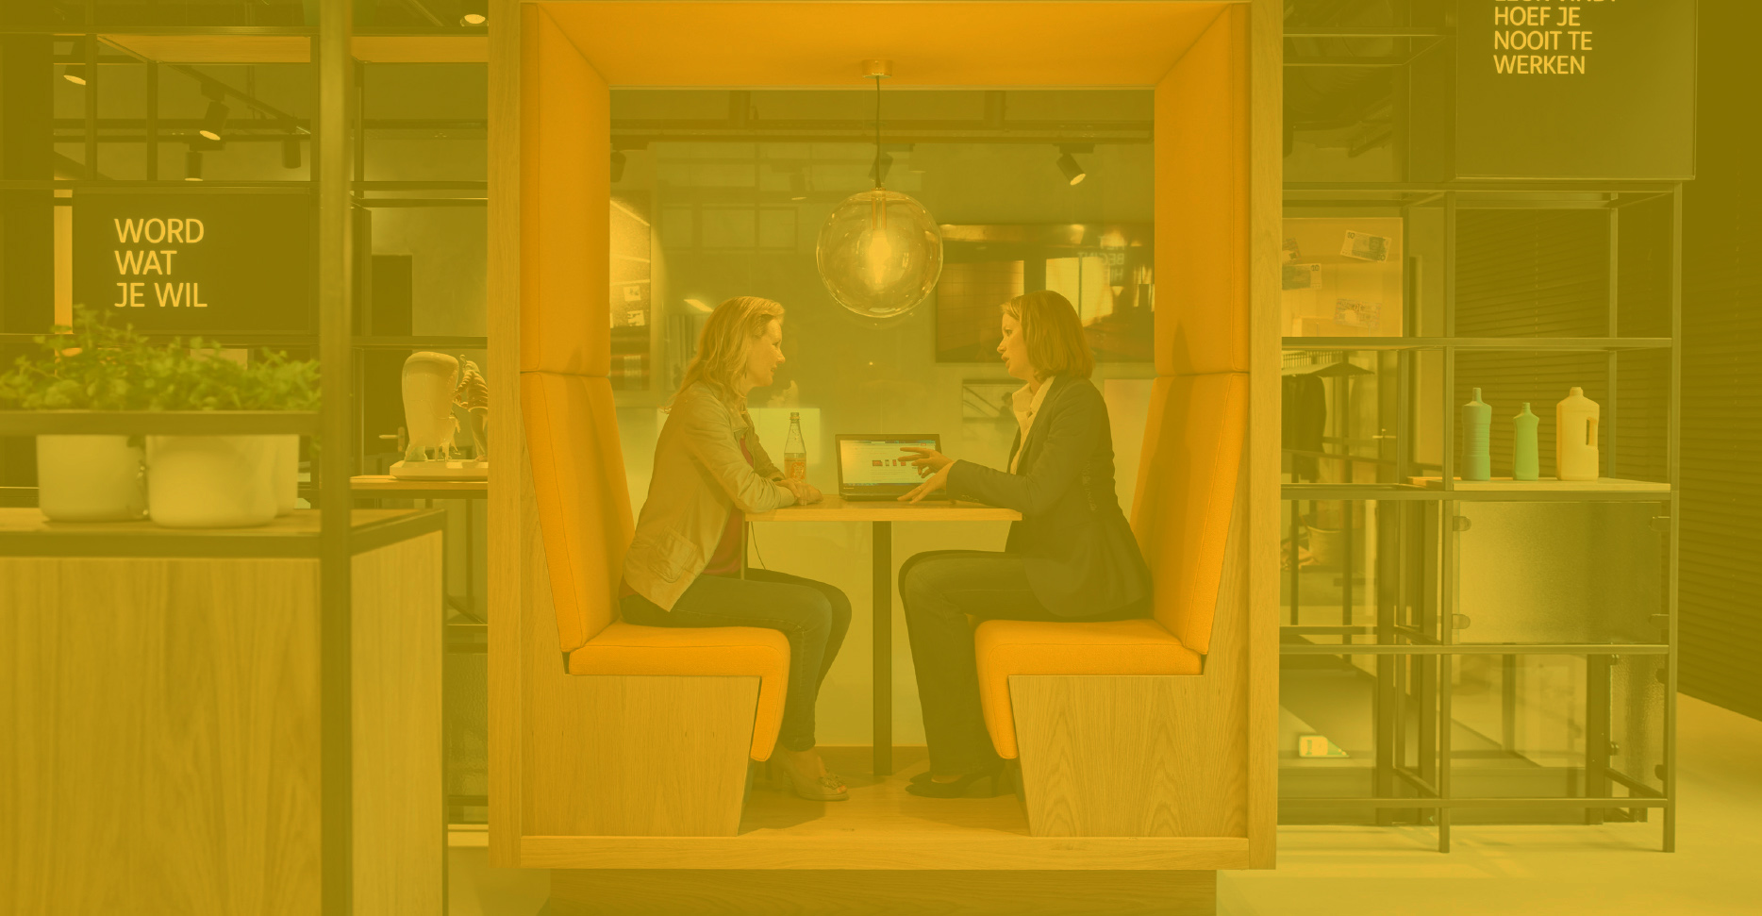
Hospitality & Community
Hospitality has become a key driver across every retail sector; from instore coffee and cocktail bars to full service restaurants. More important though is the sense of community and stores as places to learn, engage and hang out in. This is service ^{of the future.}
Category 9

Slide 23
Hospitality & Community
Please explain a little bit about this*
Add text here

Slide 24
Technology
Technology is often a gimmick in retail. Great technology should always add value to the shopping experience, either by providing retail theatre, enhancing service, or reducing friction to create a seamless and smooth shopping experience.
Category 10

Slide 25
Technology that adds value
Please explain a little bit about this*
Add text here

Slide 26
% score and judges comments
1
2
3
4
5
*/10
*/10
*/10
*/10
*/10
6
7
8
9
10
*/10
*/10
*/10
*/10
*/10
What’s good?
What could be improved?
%
*%

Slide 27
The top 30 scoring stores will be selected to go through to the next round. Echochamber and Retail Excellence will visit each store and complete our own judging audit, which will be presented back to you. The highest scoring stores will go through to the final judging panel and the awards ceremony.

Slide 28
^{Good luck!}

